Slide 1
Data Types, Functions, Objects, and Events
Module 3

Slide 2
Data Types

Slide 3
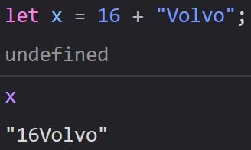
The Concept of Data Types
In programming, data types are an important concept
To operate on variables, we need to know what kind of data the variable is
Without knowing the type of the data, we cannot safely operate on it

Slide 4
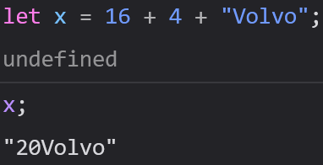
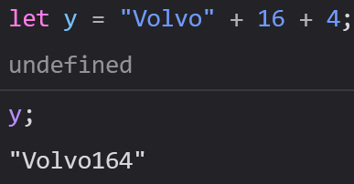
The Concept of Data Types
In the previous example, we got “16Volvo” because JavaScript treated it as “16” + “Volvo”, not 16 + “Volvo”
JavaScript always evaluates expressions from left to right and different sequences can lead to different results

Slide 5
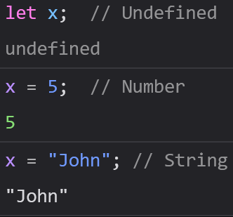
Dynamic Typing
JavaScript has dynamic types
This means that the same variable can hold different types of data

Slide 6
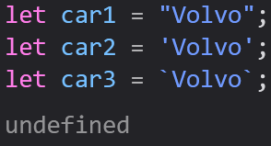
JavaScript Strings
A string (of text) is a series of characters like “John Doe” or “YWCA”
Strings are written using ‘single quotes’, “double quotes”, or `backticks`

Slide 7


JavaScript Strings
You can use quotes inside of a string as long as you use a set of quotes you haven’t used before

Slide 8
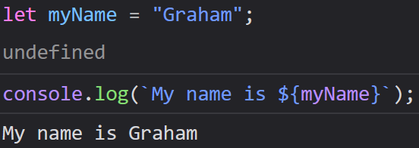
Template (Backtick) Strings
A template string allows you to insert the value of a variable directly into a string
Template strings are created using `backticks` instead of normal quotes
To insert a variable you must use the following syntax

Slide 9


JavaScript Booleans
A Boolean is a data type that can have only 2 possible values: True or False
We’ll talk about Booleans a ton when we work with conditionals

Slide 10
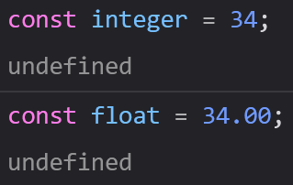
JavaScript Numbers
JavaScript only has one type of number, as opposed to other languages like Java or C++ that have both Integers (whole numbers) and Floats (decimals)
Any number can be written with or without decimals

Slide 11
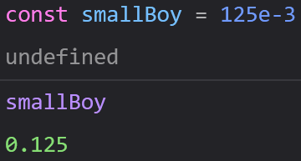
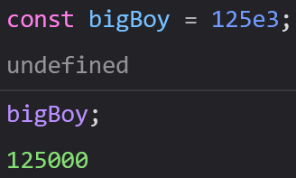
JavaScript Numbers
Abnormally large or small numbers can be written with scientific (exponential) notation

Slide 12
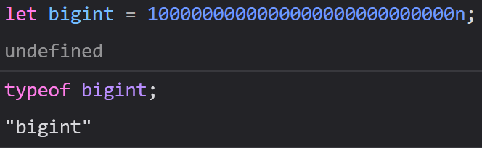
Bigint
JavaScript’s Number data type is not accurate past a certain value (15 digits)
Bigint is another data type designed to track numbers at extreme sizes and have no size limits
To create a bigint, you type an n after the end of your number

Slide 13
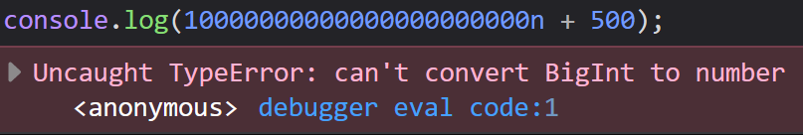
Bigint
Bigints are helpful for situations that require exact mathematical precision with large integers, like cryptography and complex computations
Bigints are a relatively new data type that were introduced in 2020
Although bigints are numbers both represent numbers, you cannot operate on both at the same time

Slide 14
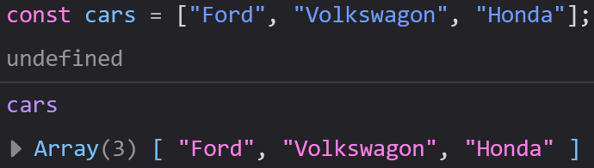
JavaScript Arrays
JavaScript arrays are written with square brackets
Array items are separated by commas
The following code declares (creates) an array called cars, containing three items (car names)

Slide 15
JavaScript Arrays
Array indexes are 0 based, which means the first item is 0, the second item is 1, etc.

Slide 16
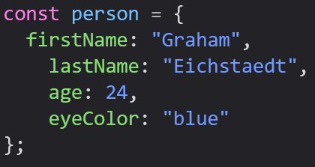
JavaScript Objects
JavaScript objects are written with curly braces
Object properties are written as name:value pairs, separated by commas

Slide 17
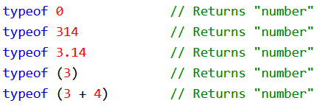

The typeof Operator
You can use the typeof operator to find the type of a JavaScript variable
The typeof operator returns the type of a variable or expression

Slide 18


Undefined
In JavaScript, a variable without a value gets the value of undefined
Its type is also undefined
We can set a variable to undefined to clear its value

Slide 19
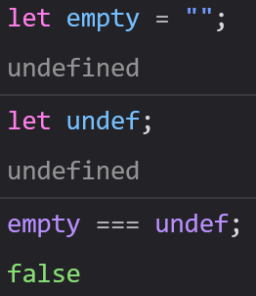
Empty Values
An empty value is not undefined
An empty string has both a value and a type

Slide 20
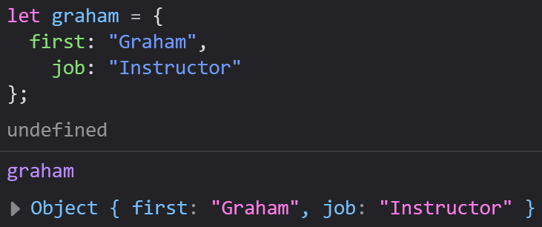
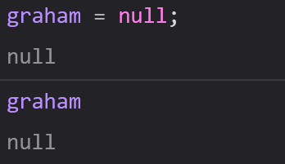
Null
In JavaScript, null is “nothing”
It is the deliberate absence of value
Another way to empty an object is to set it to null

Slide 21
Undefined vs Null
Undefined is and Null both represent the absence of value
Undefined is also the value of any variable that has not been assigned a value yet
Null is only set intentionally

Slide 22
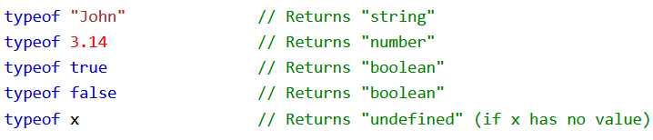
Primitive Data
A primitive data value is a single simple data value with no additional properties or methods
The typeof operator can return one of these primitive types: string, number, Boolean, or undefined

Slide 23
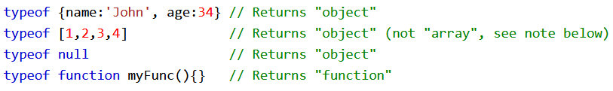
Complex Data
The typeof operator can return one of two complex types: functions, or objects
The typeof operator returns “object” for objects, arrays, and null
The typeof operator does not return “object” for functions
Notes:
In JavaScript, arrays are built out of objects

Slide 24
Functions

Slide 25

Functions
A JavaScript function is a block of code designed to perform a particular task
A JavaScript function is executed when something invokes (calls) it

Slide 26

Function Syntax
JavaScript functions are defined with the function keyword, followed by a name, then followed by parentheses
Functions follow the same naming rules as variables
The parentheses may include parameter names, separated by commas

Slide 27
Function Syntax
The code to be executed is placed inside a set of curly brackets {}
Function parameters are listed inside the parentheses () in the function definition
Function arguments are the values received by the function when it is invoked

Slide 28
Function Syntax
Inside the function, the arguments (parameters) behave as local variables
If you are familiar with any other languages, a function is the same thing as a procedure or subroutine

Slide 29
Function Invocation
The code inside of a function will execute whenever something calls the function
Functions can be called by: an event, manually in JavaScript code, or automatically

Slide 30
Function Return
When JavaScript reaches a return statement, the function stops executing
If the function was invoked from a statement, JavaScript will “return” to execute code after the invoking statement
Functions often compute a return value, which gets “returned” back to the caller

Slide 31
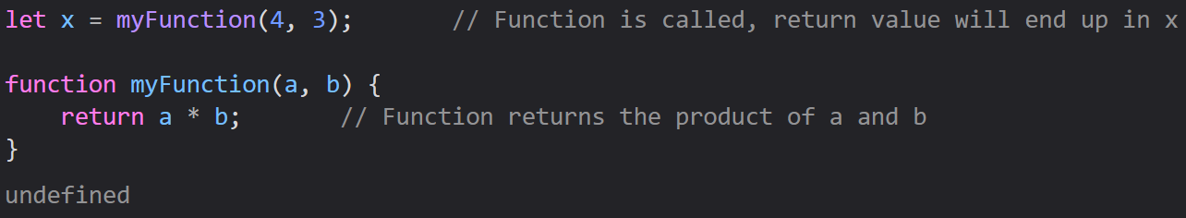
Function Return

Slide 32
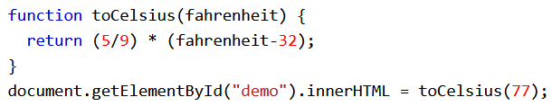
Why Functions?
Functions let us reuse code – we define them once and can use them as many times as we want
We can use the same code with different arguments to produce different results

Slide 33
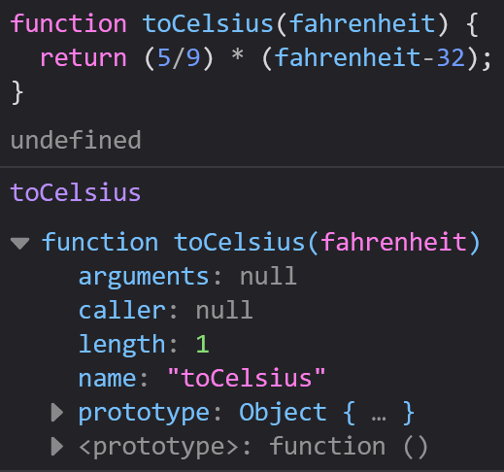

The () Operator Invokes the Function
Using the example below, toCelsius refers to the function object, and toCelsius() refers to the function result
Accessing a function without the parentheses will return a function object instead of the function result

Slide 34
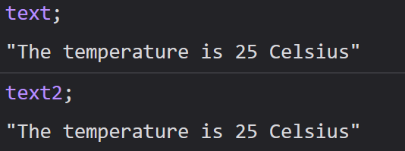
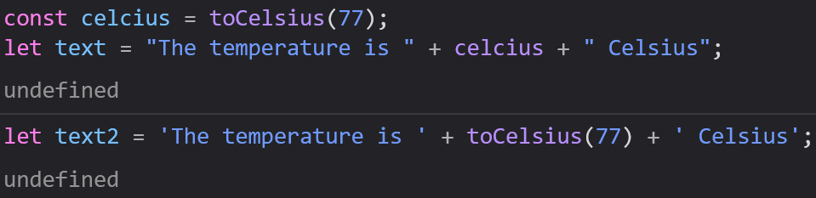
Functions Used as Variable Values
Functions can be used the same way you use variables, in all types of formulas, assignments, and calculations

Slide 35
Local Variables
Variables declared inside of a function become local to the function
Local variables can only be accessed from within the function

Slide 36
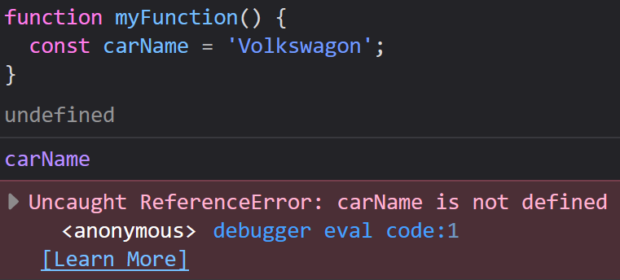
Local Variables
Since local variables are only recognized within their functions, variables with the same name can be used in different functions

Slide 37
Objects

Slide 38
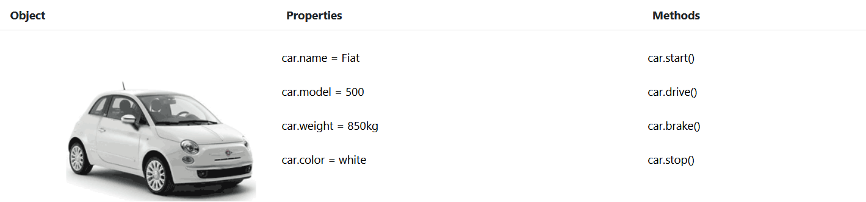
Real Life Objects, Properties, and Methods
In real life, a car is an object
Cars have properties like weight and color, and methods like start and stop

Slide 39
Real Life Objects, Properties, and Methods
All cars have the same set of properties, but the property values differ from car to car
All cars have the same set of methods, but the methods are performed at different times

Slide 40
JavaScript Objects
You have already learned that JavaScript variables are containers for data values
Objects are variables too, but objects can contain many values
This code assigns many values (Fiat, 500, white) to a variable named car

Slide 41
JavaScript Objects
The values are written as name:value pairs (a name and a value separated by a colon)
It is generally a good practice to declare objects with the const keyword

Slide 42
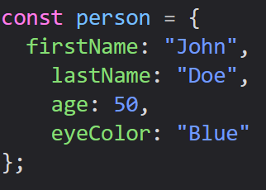
Object Definition
You define (and create) a JavaScript with an object literal
Spaces and line breaks are not important to an object’s syntax, so they can be written multiple ways

Slide 43
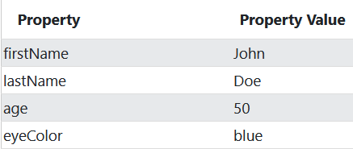
Object Properties
The name:value pairs in JavaScript objects are often called properties

Slide 44


Accessing Object Properties
You can access an object’s properties in one of two ways

Slide 45
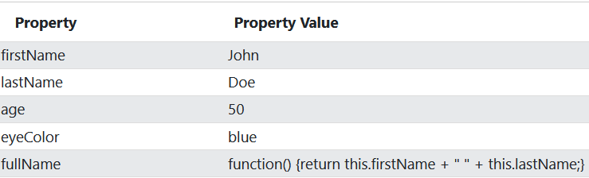
Object Methods
Objects can also have methods
Methods are actions that can be performed on objects
Methods are stored in properties as function definitions

Slide 46
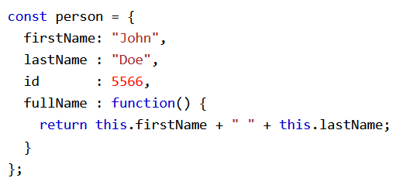
Object Methods
In this example, this refers to the person object
I.E. this.firstName means the firstName property of this
I.E. this.firstName means the firstName property of person

Slide 47
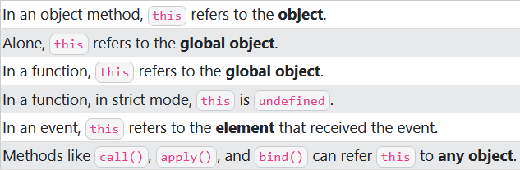
What is this?
In JS, the this keyword refers to an object
Which object depends on how this is being invoked (used or called)
The this keyword refers to different objects depending on how it is used

Slide 48
The this Keyword
In a function definition, this refers to the “owner” of the function
In the example earlier, this is the person object that “owns” the fullName function
In other words, this.firstName means the firstName property of this object

Slide 49


Accessing Object Methods
You can access an object method with the following syntax
If you access a method without the parentheses, it will return the function definition

Slide 50
Events

Slide 51
JavaScript Events
HTML events are “things” that happen to HTML elements
When JavaScript is used with HTML pages, JavaScript can “react” to these events

Slide 52
HTML Events
An HTML event can be something the browser does, or something a user does
Here are some examples of HTML events: a webpage finished loading, an input field was changed, an HTML button was clicked
Often, when events happen you want to do something

Slide 53
HTML Events
JavaScript lets you execute code when events are detected
HTML allows event handler attributes, with JavaScript code, to be added to HTML elements

Slide 54
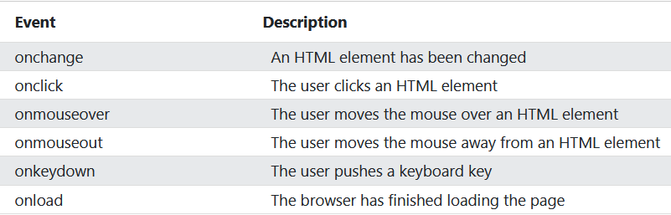
Common HTML Events

